Slide 1
Sexual Offences I: Week 13
Dr Karamvir Chadha
karamvir.chadha@durham.ac.uk
Academic Support & Feedback Hours: Wed 9-11 PCL123

Slide 2
Content Warning
This lecture and the next one address the law of sexual offences.
The cases involve facts that some students may find triggering or distressing.
If you need to leave, you may do so without explanation. You will not be asked any questions.

Slide 3
By the end of this lecture you should be able to:
explain basic statistical information about the nature of rape and the criminal justice response;
explain the legal principles of consent as defined under sections 74, 75 and 76 of the SOA 2003.

Slide 4

This is not just a topic at uni…

Slide 5
Surviving sexual violence
I believe you.
It’s not your fault.
You are not alone.
I’m sorry this happened.
Failings of the criminal law, CJS and society are no reflection on you and your experience.

Slide 6
Support
Self-care
Support at Durham:
  Student support area
  Sexual misconduct and violence
  Counselling and mental health service
  Law School Student Support Officer (Sean)
See the lecture handout for independent organisations and sources of support.
**If you are living within an abusive environment then please remember to use a “private” browser or clear your history**

Slide 7
The law is not a measure of ‘good’ sex
Wanted
Mutually respectful
Enthusiastic consent
Illegal resulting in conviction
 | Illegal but no conviction | Not illegal but ‘bad’ | ‘Good’ sex

Slide 8
Language
Person A – D | defendant
Person B – V | victim | complainant
Victim/survivor
Perpetrator
Pronouns

Slide 9
Structure of lectures
Statistics
Consent
    s 76 irrebuttable presumptions
    s 75 rebuttable presumptions
    s 74 consent
      Freedom, Choice, Capacity
Next lecture: ss 1-4 SOA

Slide 10
Sexual violence in context

Slide 11
What we know
1 in 4 women have been raped or sexually assaulted as an adult (6.54 million women in total).
1 in 18 men have been raped or sexually assaulted as an adult (1.34 million men in total).
1 in 6 children have been sexually abused.
1 in 2 adult survivors of rape have experienced it more than once.
Nature of sexual offences
1 in 2 rapes against women are carried out by their partner or ex-partner.
91% of people prosecuted for sexual offences are men aged 18+.
6 in 7 rapes against women are carried out by someone they know.

Slide 12
Sexual offences and the CJS
68,109 rapes were recorded by police between July 2022 and June 2023.
By the end of that 12-month period, charges had been brought in just 2.2% (1,498) of cases.
  Consequently, only 2 in every 100 rapes reported to the police resulted in someone being charged.
5 in 6 women and 4 in 5 men who are raped don’t report their attack to the police
  40% said ‘embarrassment’
  38% said they didn’t think the police could help
  34% said they thought it would be humiliating
Only 1% of all rapes reported to the police end in a conviction.

Slide 13
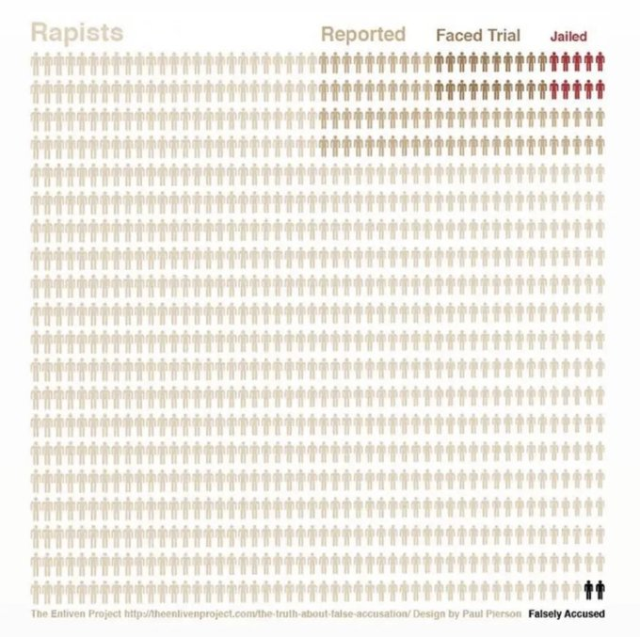

Slide 14
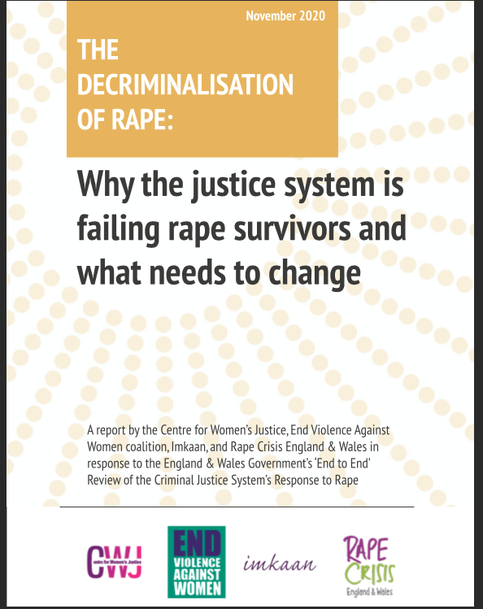

Slide 15
Rape myths in the courtroom
Temkin and Krahe (2008) empirical research into public and professional attitudes towards sexual assault:
  less blame tended to be attributed to the defendant and more blame to the complainant the closer the relationship between the two;
  men attributed less blame to the D and more to the complainant;
  information about relationship between the two influenced men and women’s blaming;
  one reason men had a greater tendency to blame the victim was that they had a greater belief in female precipitation—i.e. that women bring on a rape by their dress or behaviour;
  “female precipitation beliefs” can override other elements of evidence, e.g. in these scenarios, the use of force, active resistance and expressions of non-consent.

Slide 16
Consent and sexual offences Act 2003 ss1-4

Slide 17
Consent
At the core of most serious sexual offences under the Sexual Offences Act 2003 (hereafter SOA).
  Break from the past.
  Consent not restricted to use of force or threats, nor if against her will.
But, the law has struggled to define consent in positive terms.
  The jury are left with a significant level of discretion.
  Points of law, not a full definition.
In SOA absence of consent is part of actus reus, not mens rea!

Slide 18
Elements of rape
AR
Penetration with a penis
Of the vagina, anus or mouth
Without consent
MR
Penetration is intentional
A does not reasonably believe that B consented

Slide 19
Determining consent
Three routes to determining consent under SOA:
  general definition of consent (s74);
  evidential/rebuttable presumptions re no consent (or reasonable belief) (s75);
  conclusive presumptions re no consent (or reasonable belief) (s76).
Legal consent often falls short of popular definition.
  Remember you are striving for enthusiastic consent and wanting!
Self-possession? Akin to slavery? (Rubenfeld, 2013)

Slide 20
Section 76
Conclusive presumptions rebutting consent and belief in consent

Slide 21
Conclusive presumption
Prosecution need to prove 2 elements:
  the relevant act (ss1-4 of SOA);
  any one of the circumstances in s76(2)
then it is conclusively proven:
  that the complainant did not consent to the relevant act, and
  that the defendant did not believe that the complainant consented to the relevant act.
This is about deceit.
It is not a matter of evidence.

Slide 22
Section 76(2)(a)
The defendant intentionally deceived the complainant as to the nature or purpose of the relevant act.
Intentional deception required, not in cases where:
  A has not intended to deceive B.
  Where B has unilaterally formed a false understanding as to the nature or purpose of A.
    Even if A is aware of B’s mistake.

Slide 23
Limited reach
Cases under pre-SOA laws relate to B not understanding the mechanics of sex:
  Flattery (1877) 2 QBD 410: believed it was surgery, not intercourse.
  Williams [1923] 1 KB 340: believed the act was to open an air passage to improve her singing, not that he was having sex with her.
Under SOA, where B has been defrauded as to the purpose of the act that A performs, s76 creates a conclusive presumption that B is not consenting.
Jheeta [2007] EWCA Crim 1699:
  A told B she must have intercourse with him to avoid being fined by the police and to avoid him committing suicide.
  B was not considered to have been deceived as to the nature of the mechanics of intercourse, nor the purpose.

Slide 24
Section 76(2)(b)
The defendant intentionally induced the complainant to consent to the relevant act by impersonating a person known personally to the complainant.
Not simply A lying about identity, must be that by an impersonation B was induced to consent.
  Prosecution must prove casual link.
  See Elbekkay [1995] Crim LR 163.
Must be an impersonation of a person known personally to B.
Deception of A’s attributes not covered, i.e. if A deceives B into believing his is a medical professional,
  see Richardson [1998] 2 Cr App R 200, a NFOAP case.

Slide 25
Distinction between s74 and s76
Assange v Swedish Prosecution Authority [2011] EWHC 2849 (Admin) settled the matter as to whether deception could fall within s74 as well as s76, or if s76 was considered to be exhaustive.
In recent cases we have seen a reluctance by the courts to rely on section 76 in cases of deception, likely due to the nature of the conclusive presumption that mandates guilt.

Slide 26
Section 75
Evidential/rebuttable presumption of consent

Slide 27
Section 75(1)
Prosecution need to prove 3 elements:
  the relevant act (ss1-4 of SOA);
  circumstances giving rise to the presumption (outlined in s75(2));
  A’s knowledge of the circumstances.
then A is obliged to raise sufficient evidence to rebut the issue.

Slide 28
Circumstances
any person was using violence against the complainant or causing the complainant to fear that immediate violence would be used against him;
any person was causing the complainant to fear that violence was being used, or that immediate violence would be used, against another person;
the complainant was, and the defendant was not, unlawfully detained;
the complainant was asleep or otherwise unconscious;
because of the complainant's physical disability, (s)he would not have been able to communicate consent to the defendant
any person had administered to or caused to be taken by the complainant a substance which stupefied or overpowered the complainant.

Slide 29
Evidence to rebut
If he cannot then,
  the complainant is to be taken not to have consented to the relevant act
  the defendant is to be taken not to have reasonably believed that the complainant consented
i.e. no defence, jury bound to find him guilty.
Note A can raise evidence on to rebut either or both.

Slide 30
Evidential burden for rebuttal
A has to satisfy the judge, from the evidence, that there is a real issue about consent worth putting to the jury.
If evidence is presented then it is for the jury to determine if they accept it.
Jury should only hear about s75 if judge decides no evidence capable of rebutting s75.
Evidence must be more than merely speculative or fanciful
    Cicarelli [2011] EWCS Crim 2665.
Will only be ‘relatively rare cases where the judge decides that there is not sufficient evidence on one or both of the issues, [and so] a section 75 direction must be given on that issue’
    White [2010] EWCAS Crim 1929, at 10.

Slide 31
Section 74
General definition of consent

Slide 32
Definition under section 74
For the purposes of this Part, a person consents if he agrees by choice, and has the freedom and capacity to make that choice.
Something given – positive act.
Freedom
Choice
Capacity

Slide 33
Freedom

Slide 34
‘Free agreement’
Absence of protest, resistance, or injury not needed to signify there is no consent.
Timing—the consent is present at the time of the sexual act(s), i.e. consenting earlier is not sufficient.
Assumes freedom from something, and so the jury have to address the existence and weight of the ‘other’ pressure from which B might have been acting freely.
  Greater ‘pressure’ experienced by B means less ‘freedom’ to choose.
Level of freedom required to validate consent is not clear, i.e. economic pressures.
Levels of pressure that negate freedom will depend on a range of factors, so judged on the basis of case-by-case.

Slide 35
C [2012] EWCA Crim 2034
D sexually abused V from age of 5 until she was 25 years old.
Convicted of offences relating to child sexual abuse (for incidents when under 16), and sexual offences based on consent (for incidents when over 16).
D appealed conviction arguing that after she had turned 16 years, V had consented to sexual activity, thus was not an offence under SOA.
    ‘… the reality of this case cannot be understood without reference to the long years of the complainant's childhood during which, as the jury found, she was the victim of repeated sexual abuse by the appellant.
    …
    Dealing with it generally, her evidence was that she felt trapped and afraid of the appellant even after she left home. Throughout her childhood and after she grew up, his attitude to her was domineering, aggressive and controlling’.
See also Kirk [2008] EWCA Crim 434.

Slide 36
Consent versus submission
The courts have drawn a distinction between submission and consent, although the line between them can be difficult to determine.
Olugboja [1982] QB 320:
    ‘… every consent involves a submission, but it by no means follows that a mere submission involves consent’.
Doyle [2010] EWCA Crim 119:
  Context of intimate partner violence and abuse.
    ‘…but once he had succeeded in penetrating her she ceased to resist because she thought it would only get worse if she did. As she put it, “I then let him get on with it”. The appellant ejaculated, stood up, and threw the complainant's clothes at her. He asked if she had enjoyed it, when she said “no”, according to the complainant's evidence, he slapped her’.
  The appeal was on the basis that the judge’s direction to the jury about consent was inadequate.

Slide 37
Consent versus submission
See also Ali [2015] EWCA Crim 1279 on grooming:
  Although grooming did not necessarily vitiate consent, it did starkly raise the possibility that a vulnerable or immature individual might have been placed in a position in which he or she was led merely to acquiesce rather than give proper or real consent.
  Grooming had a tendency to limit or subvert the alleged victim’s capacity to make free decisions and it created the risk that he or she simply submitted because of the environment of dependency created by those responsible for treating the victim in that way.

Slide 38
Submission with consent
Submission does not necessarily mean lack of consent (in law),
  A person does not really want to have sex (so is reluctant) but nevertheless consents.
  Reluctant consent is still consent. This is clearly a difficult distinction to draw, hence why guidance from a judge is needed, as per Doyle:
    ‘… there are circumstances in which the jury may well require assistance as to the distinction to be drawn between reluctant but free exercise of choice on the one hand, especially in the context of a long term and loving relationship, and unwilling submission to demand in fear of more adverse consequences from refusal on the other’.
In opposition to claim in Olugboja, to consent does not always mean to submit,
  Active enthusiasm!
  Notion that women always submit to sex men want to have is sexist!

Slide 39
Choice

Slide 40
B having options to choose from
Outlined in Assange v Swedish Prosecution Authority [2011] EWHC 2849 (Admin) that “choice” is crucial to the issue of “consent”:
  Assange knew that AA would only consent to sexual intercourse if he used a condom throughout, but he had concluded sexual intercourse with her without a condom.

Slide 41
R (on the application of F) v DPP
[2013] EWHC 945 (Admin): Judicial review:
B did not want to become pregnant, and consented to her husband having sexual intercourse with her on that basis that he would withdraw his penis before ejaculating.
During intercourse, shortly after penetration he told her that he would be ejaculating within her vagina “because you are my wife and I'll do it if I want”. He ejaculated before she could object or do anything about it, and she became pregnant as a result.
Context of intimate partner violence and abuse, and sexual domination.
Held, allowing the claim:
    ‘…she agreed by choice, when she had the freedom and capacity to make the choice … “choice” is crucial to the issue of “consent”, and indeed we underline that the statutory definition of consent provided in section 74
    …
    he decided that he would not withdraw at all, just because he deemed the claimant subservient to his control, she was deprived of choice relating to the crucial feature on which her original consent to sexual intercourse was based. Accordingly her consent was negated’.

Slide 42

How much information does B need for her to choose to consent?

Slide 43
Failure to disclose versus active deception
Prior to Lawrance the courts distinguished between A’s failure to disclose (McNally), which does not fall under s74, and active deception (B), which does.

Slide 44
Failure to disclose
B [2006] EWCA Crim 2945:
  A was HIV positive, did not inform B of his of his HIV status, B did not ask.
  Trial judge directed the jury:
      ‘… when you are considering whether [the complainant] consented to intercourse you will need to consider whether she had the freedom and capacity to make the choice as to whether to have intercourse with this man if she did not know he was HIV-positive …’
  A was convicted, later appealing his conviction, arguing his HIV status should have been irrelevant to the question of sexual consent (note this is about sexual consent and not consent under OAOP 1861, as covered in NFOAP lecture).
      ‘All we need to say is that, as a matter of law, the fact that the defendant may not have disclosed his HIV status is not a matter which could in any way be relevant to the issue of consent under section 74 of the 2003 Act in relation to the sexual activity in this case’.

Slide 45
Active deception
McNally [2013] EWCA Crim 1051:
  A (female but purporting to be a boy called S), conducted an internet relationship with a girl, M. S met M, while presenting herself as a boy, and sexual conduct occurred, including penetration of M's vagina.
  On the fourth and final visit S revealed that she was a girl.
  In a full account given to the police M said that she considered herself heterosexual and had consented to the sexual acts because she believed she was engaging in them with a boy called S.
  S pleaded guilty to six counts of assault by sexual penetration contrary to section 2 of SOA.
  She appealed against conviction on the ground, inter alia, that the elements of the offence were not made out because a deception as to gender could not vitiate consent.
  Held, dismissing the appeal against conviction:

Slide 46
The law after Lawrance
Lawrance [2020] EWCA Crim 971:
  A told B that he had had a vasectomy and so she could not get pregnant. On this basis B agreed to have sex with A without a condom.
  After they had had sex, A left a note that he had lied and he was fertile.
  A later found out she was pregnant.
  … it makes no difference to the issue of consent whether, as in this case, there was an express deception or, as in the case of B, a failure to disclose. [41].

Slide 47
Wider circumstances of the act and deception
In McNally, noted A’s deception about wider circumstances related to the sexual activity cannot vitiate A’s consent, e.g. age, marital status, wealth.
  R (on the application of Monica) [2018] EWHC 3508 (Admin):
    Undercover police officer.
    Does not relate to the sexual intercourse itself rather but rather the broad circumstances surrounding it.
    Does not vitiate consent.
See also Lawrance [2020] 2 Cr App R 29:
  A lied about fertility (did not vitiate).
But following did as relate to sexual intercourse itself:
  Assange v Swedish Prosecution Authority – condom use.
  R (on the application of F) v DPP – agreement to withdraw pre-ejaculation.
  McNally – sex of sexual partner.

Slide 48
Capacity

Slide 49
Having capacity to choose
At the time of the sexual activity (not before).
  Based not on B’s status, but about capacity to make the decision to engage in sexual act with this person
  C (Cooper) [2009] UKHL 42:
    ‘the case law on capacity has for some time recognised that, to be able to make a decision, the person concerned must not only be able to understand the information relevant to making it but also be able to “weigh [that information] in the balance to arrive at [a] choice”...’.

Slide 50
Intoxication
Questions of rape following voluntary intoxication hinge on whether:
  B remains capable of choosing whether or not to have intercourse, and in her drunken state agreed to do so—this would not vitiate consent.
  B temporarily loses capacity to chose whether or not to have intercourse on that occasion then she was not consenting—subject to A’s mens rea, if intercourse takes place then this would be rape.
This is not about lower inhibitions, regret, or inability to remember, it is about capacity to consent.

Slide 51
Bree [2007] EWCA Crim 804
Prosecution claim B was effectively unconscious and incapable of consenting following voluntary intoxication, and so A had raped her.
A was convicted, but appealed on the basis of lack of direction on intoxicated consent by the judge to the jury.
Held, conviction unsafe and so quashed:
    ‘We should perhaps underline that, as a matter of practical reality, capacity to consent may evaporate well before a complainant becomes unconscious. Whether this is so or not, however, is fact-specific, or more accurately, depends on the actual state of mind of the individuals involved on the particular occasion.
    …
    The problems do not arise from the legal principles. They lie with infinite circumstances of human behaviour, usually taking place in private without independent evidence, and the consequent difficulties of proving this very serious offence’.
Kamki [2013] EWCA Crim 2335 outlined issues judges need to take into account when drafting guidance for juries.

Slide 52
Intoxication & absence of consent
H [2007] EWCA Crim 2056, the Court of Appeal, confirmed that there is no need for the prosecution to demonstrate the absence of consent, nor that this was communicated to the defendant for the actus reus of rape to exist.
  If B cannot remember what happened, for example.

Slide 53
Drunken sex
Please remember that the law is providing a basic minimum standard for conduct that falls under the remit of the criminal law; rather than what you should strive for in your sexual lives. If you are in any concerns that the person you are with is too drunk to consent to, or to want to have sex then please do not have sex with them, even if you have had sex before.

